Slide 1
Predicting a Stroke with RShiny
Andrew Naranjo, Wellington Gray III, Carlos Medina, Daniel Hogan
Mentors: Dr. Chang and Deepak Bastola

Slide 2

Roadmap
Background
The Dataset
Our Process
Data Cleaning
Steps Going Forward
Conclusion
Sources

Slide 3
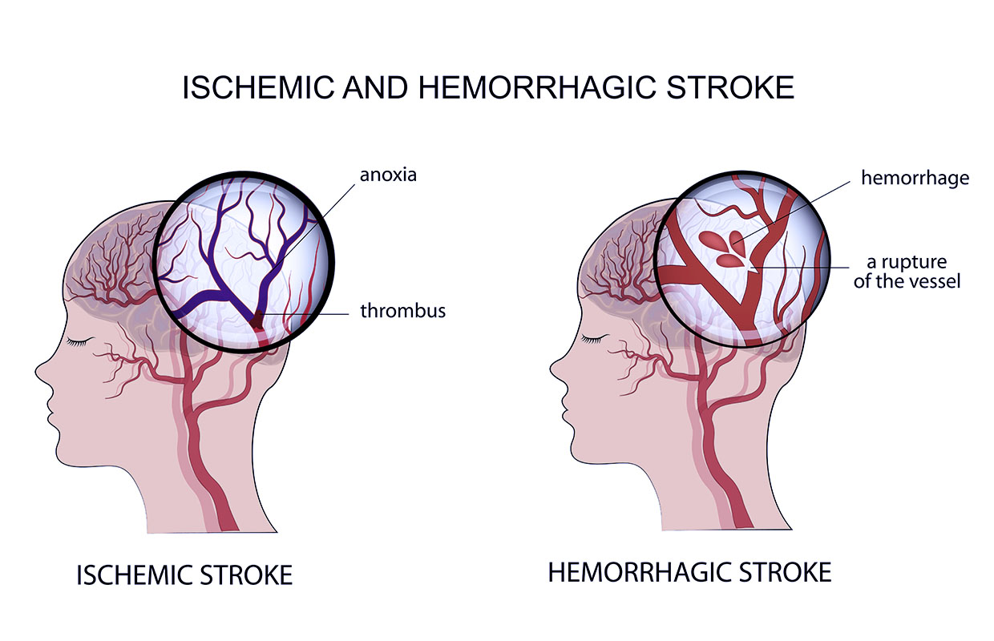
Background
A stroke is defined as a neurological deficit caused by vascular injury
Two types: Ischemic & Hemorrhagic
Temporarily in compromised state

Slide 4
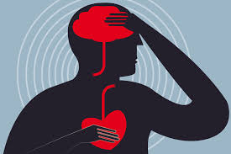
Background
1 in 20 people deaths are caused by strokes (UTMB)
80% of these deaths are preventable (UTMB)
The U.S. alone loses $68,000,000,000 due to stroke in productivity, medical and labor losses per year.

Slide 5
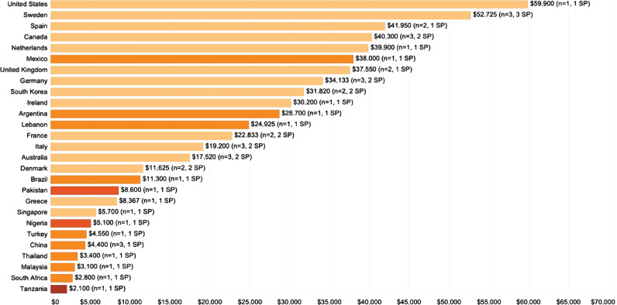
Background
Cost estimates aggregated by country. Colors represent income classification (Strilciuc)

Slide 6

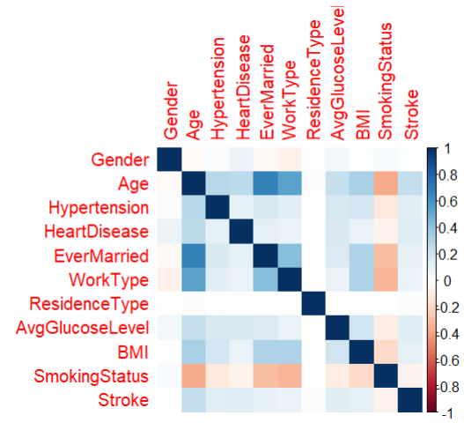
The Dataset
The dataset was sourced from Kaggle
Purely for educational purposes to predict strokes
There is no temporality that was established
The dataset had 11 variables to predict a stroke

Slide 7
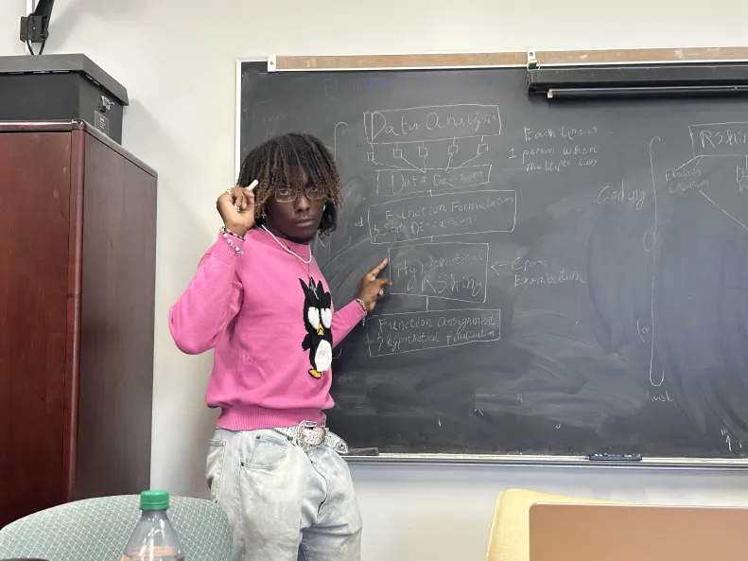
Our Process
Created a step by step flowchart of how we would go about completing the project
Divided the work between group members based on individual strengths
Collaborated in order to combine our findings

Slide 8
Data Cleaning
We filtered out:
All participants that were under the age 18
Those whose smoking status was unknown
Those who had never worked
One participant who identified as other
Then we:
Converted certain variables into factors
Imputed missing data to account for NAs
Created dummy variables for training our model
Accounted for covariance and zero variance predictors
Used Smote to account for immense class imbalance
This resulted in a sample size of 4254

Slide 9
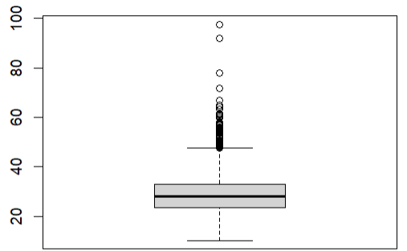
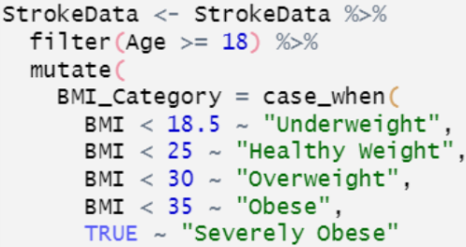
Data Cleaning
110 Outliers
2.58%

Slide 10
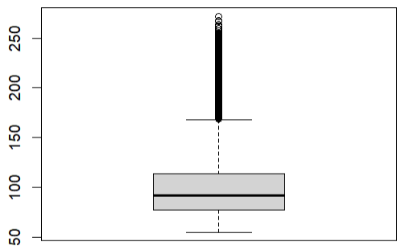
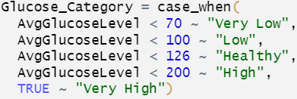
Data Cleaning
594 Outliers, n = 4254
13.96%

Slide 11

Steps Going Forward
Utilize a dataset that establishes temporality in order to identify causation
Fine tune code to dynamically showcase a participant’s coefficient breakdown.
Implement a tab that provides tailored advice to participants on how to minimize their stroke risks based on their variable breakdown analysis.
Experiment with alternative machine learning models in order to possibly implement a more accurate model.

Slide 12
Thank You!
Special thanks to Dr. Chang and Deepak Bastola!

Slide 13
Sources
https://www.emro.who.int/health-topics/stroke-cerebrovascular-accident/index.html
https://www.nhlbi.nih.gov/health/stroke
https://www.kaggle.com/datasets/fedesoriano/stroke-prediction-dataset
https://www.ncbi.nlm.nih.gov/pmc/articles/PMC8742896/
https://www.utmbhealth.com/services/neurology/procedures-conditions/stroke/stroke-facts#:~:text=Stroke%20kills%20about%20140%2C000%20Americans,United%20States%20have%20a%20stroke.
https://www.healthline.com/health/stroke/stroke-prognosis#recovery-time
https://www.ninds.nih.gov/health-information/stroke/stroke-overview

Slide 14


Stroke Bad :(
Strokes cost the average patient $60,000 per year in treatment following their diagnosis, and over $150,000
The U.S. alone loses $68,000,000,000 due to stroke in productivity, medical and labor losses per year. In just 8 years. For comparison, in just two years the U.S. loses more money due to stroke than Europe did in infrastructure during WWII.
1 in 5 women will suffer a stroke at some point in her life, this proportion increases with age. Stroke is the 3rd leading cause of death in women in the U.S. and the 2nd leading cause of death globally.
The risk of stroke doubles every decade after 55 years of age.
Survivors of stroke have their life expectancy cut by ~6 years on average.
~2 out of 3 people who have an Ischemic stroke either die or need care for others within 5 years. ~3 out of 4 people who suffer from a hemorrhagic stroke die or need disability care within 5 years.

Slide 15
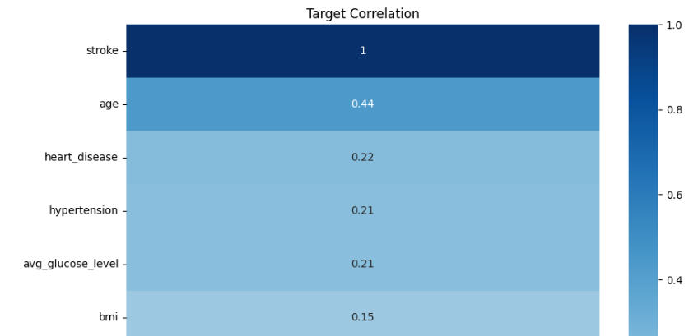
Dataset Summary
Based upon Systematic Review of various papers measuring stroke risks, blood pressure is the largest risk factor in having a stroke.

